Slide 1
Online Quiz System
Under the Guidance of: submitted BY:
Mrs. Vidushi MISHRA
Rahul dadoo
omveer singh
vinay kumar

Slide 2
INTRODUCTION
We have designed this website with the purpose of allowing the students to give exams and view their results. This site is an attempt to remove the existing flaws in the manual system of conducting exams. Students are provided the flexibility to choose among different types of aptitude and programming language tests.

Slide 3
Advantages
Our new system will reduce the work as well as time which was spent when driver used to travel in all the location and check whether the bin is empty or full.
• This System will help to keep the city clean.
• The IR sensor in the trash bin will give the accurate status of the bin.

Slide 4
Features of System
Physical presence at a given location is absolutely not necessary .
• No time is spent on evaluation question Paper.
• Random generation of test question Timed exams .
• Being an integrated Online examination system it will reduce paper work.
• The result will be shown immediately to the participating students .

Slide 5
Modules
Registration of Teacher and Student
Making of quiz
Taking of quiz
Performance of student

Slide 6
System Requirements
Technologies used
Asp.net Mvc
Html
Css , Bootstrap
C#
Sql Server

Slide 7
Working Environment
Software Configuration
operating system : Window 10
Design tool(IDE) : Visual studio 2019
Database : Sql Server (Sql Server Management Studio)

Slide 8
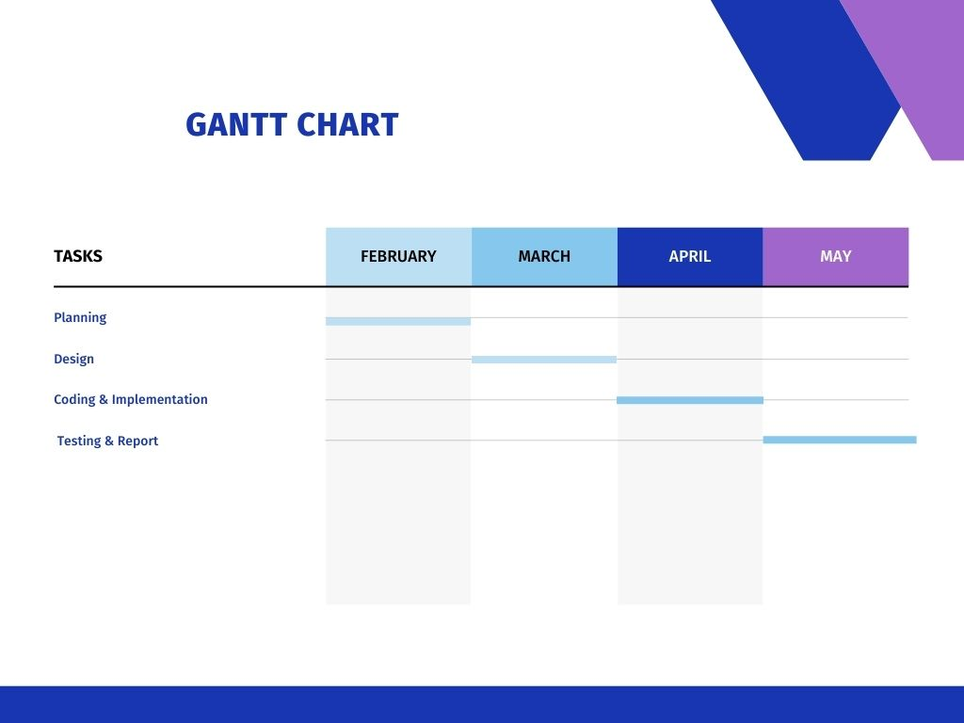
GANTT CHART

Slide 9
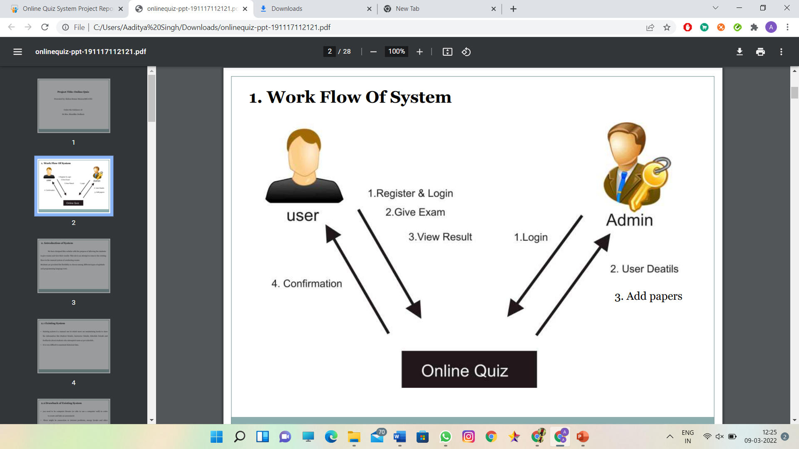
WORK FLOW SYSTEM

Slide 10

Welcome Page

Slide 11
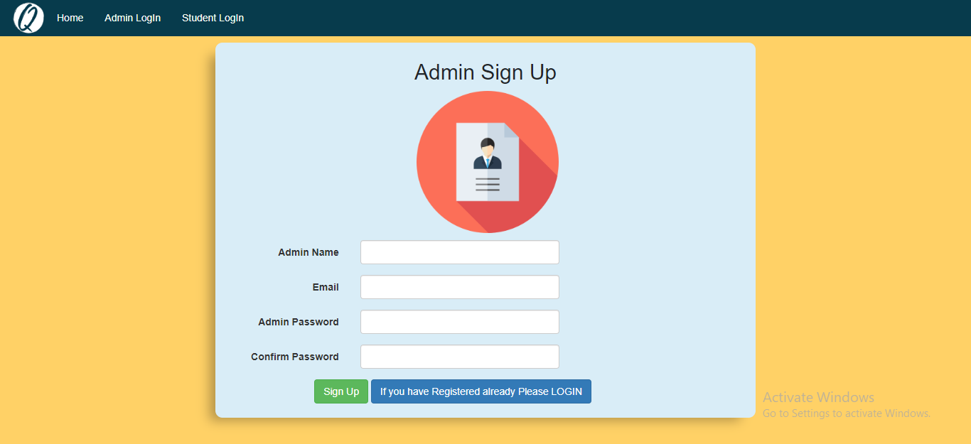
Registration Pages

Slide 12
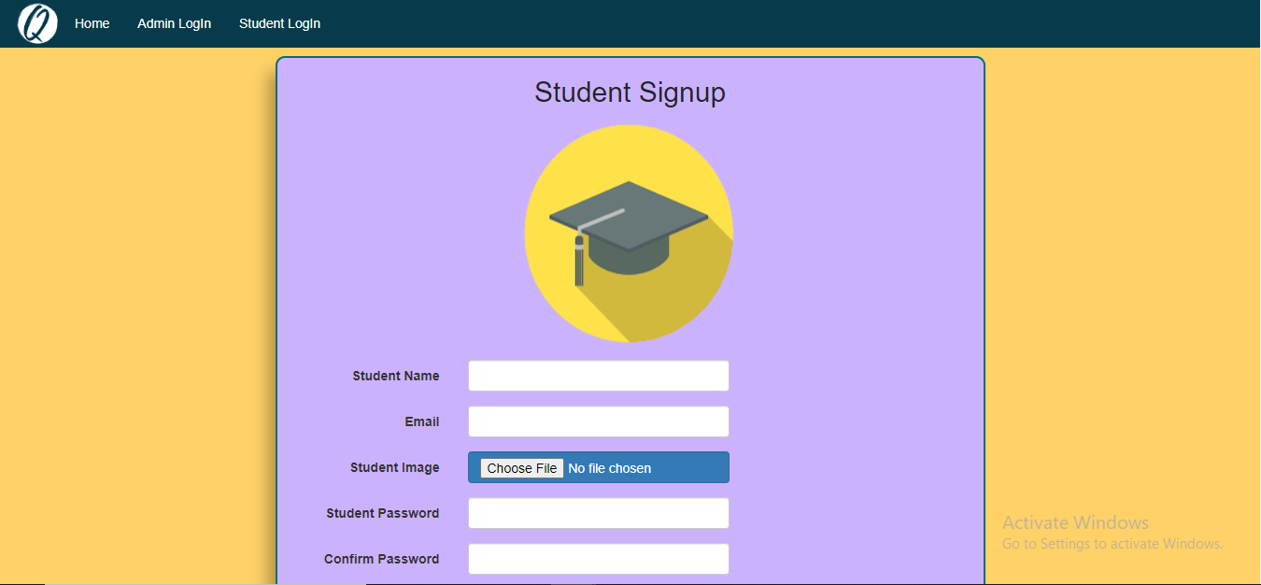
Registration Pages

Slide 13
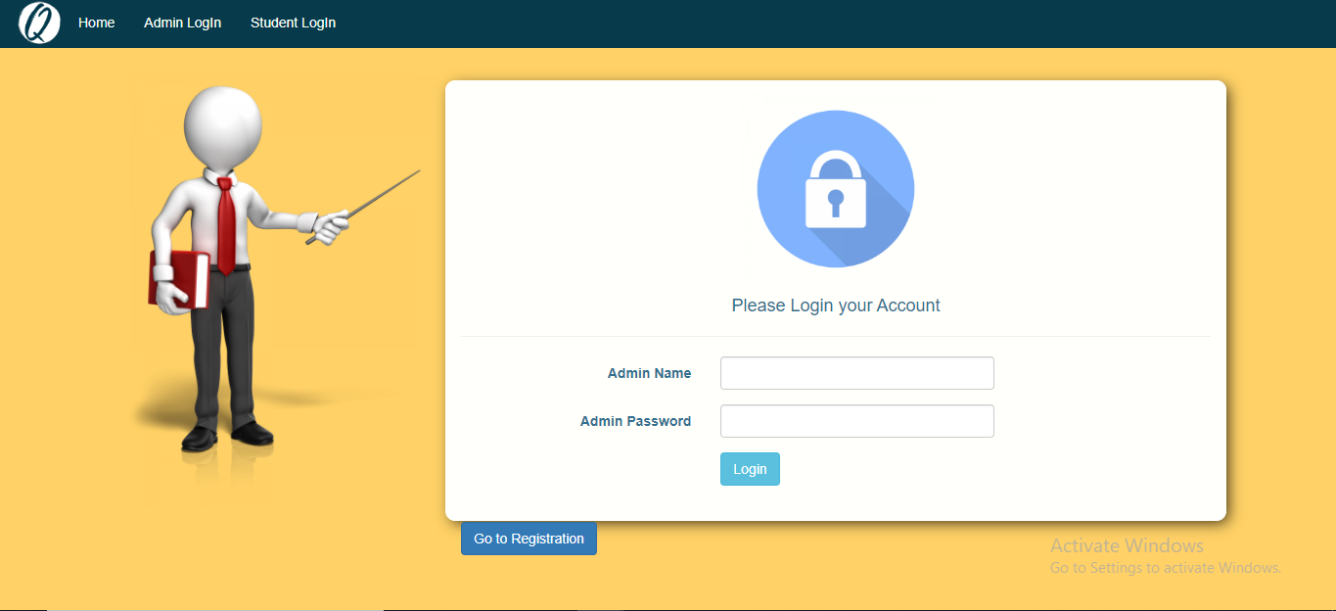
Login Pages

Slide 14
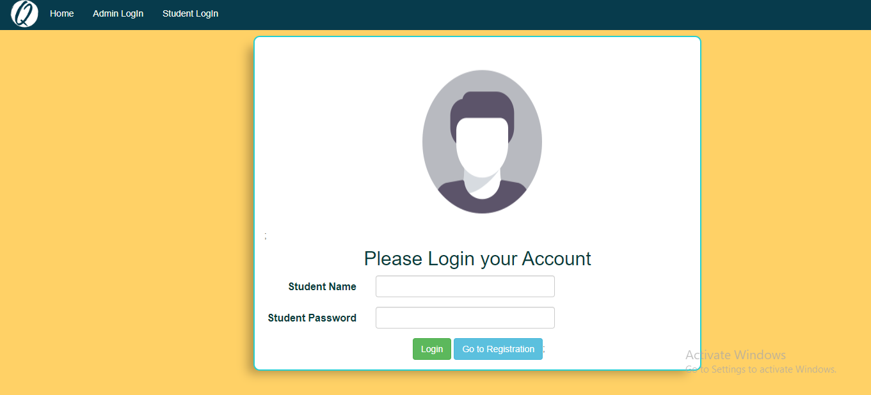
Login Pages

Slide 15


